Slide 1


Waste and pollution
Dsc 680 project one
Krystina Moses

Slide 2
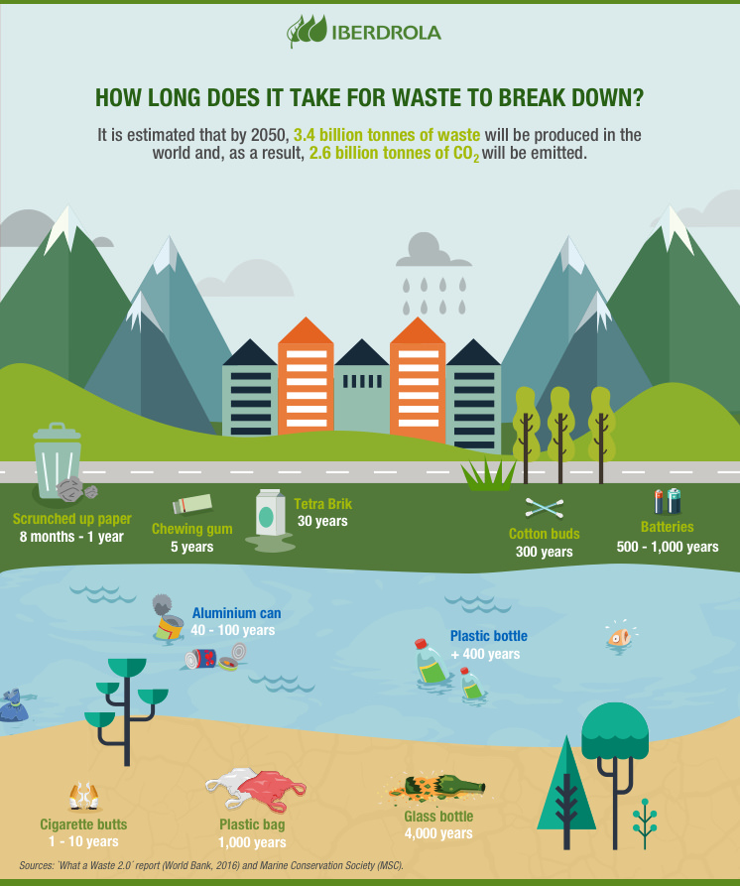
Introduction/background
The United States alone produced more waste than other countries, about 12%, compared to what it recycled.
Solid waste has been increasing over the years starting from about 88 million tons in the 60’s to over 268 million tons in 2017.
There are over 1,000 hazardous waste sites in the United States alone and with the amount of waste in the areas, it contaminates the air, soil, and water.
When recycling happens, it can decrease the amount of waste going to landfills which in turn, saves the contamination from all around us.
From a financial standpoint, recycling saves money.

Slide 3
Primary dataset / categories of waste
This dataset was used to show the categories of waste broken down, in 1,000 tons.
https://www.epa.gov/facts-and-figures-about-materials-waste-and-recycling/studies-summary-tables-and-data-related
 | Year | Paper | Glass | Metals | Plastics | Rubber Leather | Textiles | Wood | Other
4 | 1960 | 29990 | 6720 | 10820 | 390 | 1840 | 1760 | 3030 | 70
5 | 1970 | 44310 | 12740 | 13830 | 2900 | 2970 | 2040 | 3720 | 770
6 | 1980 | 55160 | 15130 | 15510 | 6830 | 4200 | 2530 | 7010 | 2520
7 | 1990 | 72730 | 13100 | 16550 | 17130 | 5790 | 5810 | 12210 | 3190
8 | 2000 | 87740 | 12770 | 18940 | 25530 | 6670 | 9480 | 13570 | 4000

Slide 4
Secondary dataset / generated waste totals
 | Year | Generated Waste
4 | 1960 | 88.1
5 | 1970 | 121.1
6 | 1980 | 151.6
7 | 1990 | 208.3
8 | 2000 | 243.5
This dataset was used to show the amount of waste generated over the years, in millions.
https://www.statista.com/statistics/186256/us-municipal-solid-waste-generation-since-1960/

Slide 5
Dataset descriptions
Column Name | Data Type | Description
Year | integer | Year of recorded data
Paper | integer | Paper and paperboard in 1,000 tons
Glass | integer | Glass in 1,000 tons
Metals | integer | Metals in 1,000 tons
Plastics | integer | Plastics in 1,000 tons
RubberLeather | integer | Rubber and Leather in 1,000 tons
Textiles | integer | Textiles in 1,000 tons
Wood | integer | Wood in 1,000 tons
Other | integer | Uncategorized materials in 1,000 tons
Generated Waste | integer | Amount of generated waste in millions per year

Slide 6
Data preparation/ exploratory data analysis
Verifying the data had no missing or NaN values
Renaming columns to ensure they were all the same format and for easy reading
Verifying the type of information on the dataset
Data visualizations to better understand the data

Slide 7
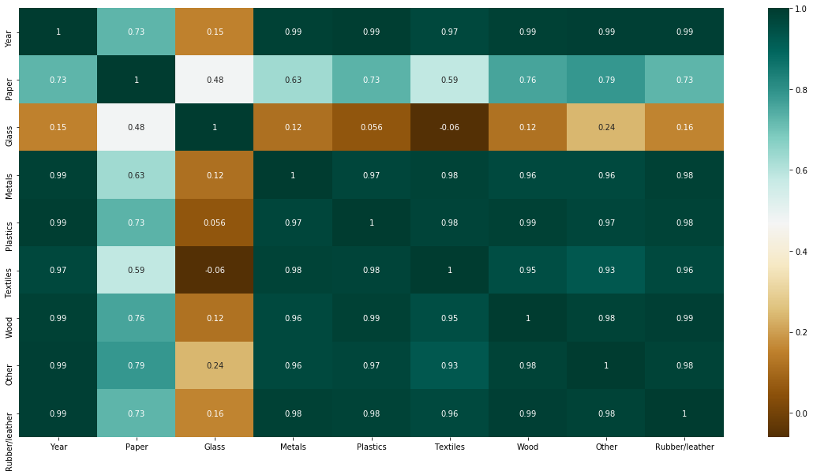
Understanding the Data
A correlation matrix was created to see the relationship between the variables. This determined paper and glass are the least related and affected by the other materials.

Slide 8
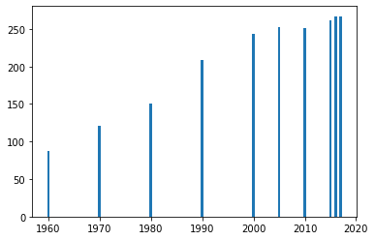
graphs
Generated waste in millions per year

Slide 9
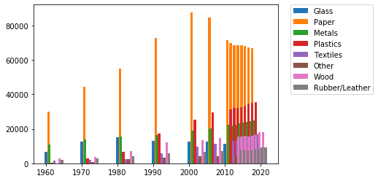
graphs
Materials in 1,000 tons

Slide 10
models
Data cleaning, exploratory data analysis, and visualization methods were created and analyzed using Python, specifically Jupyter Notebook.
The target variable was the waste generated and then this was broken down into different materials individually.

Slide 11
Results/conclusion
The amount of waste in millions is shown as rapidly increasing as the years go on. In 2017, 26.8 million tons of plastic were sent to landfills.
It was determined that the amount of waste has been increasing over the years and the primary material found is paper and paperboard. Throughout the years, there has been an increase in plastic waste; however, a decrease in glass. With the decrease in glass, it tells me that this is due to recycling. A lot of glass is also repurposed to serve other needs for people.
Plastics can take up to 400 years to break down and a lot can happen within that time.
While the amount of waste keeps piling up, the data also has been evolving in ways to identify certain waste products to pull from landfill. The more we can identify, the more machines can pull.
There are solutions that we can take now to reduce the amount of waste we are producing. Some of those solutions include buying in bulk, choosing to reuse a water bottle, using utensils from home, using a reusable bag, and simple things like cutting the strings off disposable masks can help with sea life. A lot of waste comes with mindfulness. If we do not take care of our planet, the amount that will be available to us in the future is diminishing minute by minute.

Slide 12
references
7 Easy Ways to Reduce Plastic Waste. (2016, September 30). Retrieved from https://www.keeptruckeegreen.org/7-easy-ways-reduce-plastic-waste/
Advancing Sustainable Materials Management: Facts and Figures Report. (2020, April 03). Retrieved from https://www.epa.gov/facts-and-figures-about-materials-waste-and-recycling/advancing-sustainable-materials-management
Boulissière, S. (2019, March 17). The countries polluting the oceans the most with plastic waste. Retrieved from https://www.plasticethics.com/home/2019/3/17/the-countries-polluting-the-oceans-the-most-with-plastic-waste
Corporativa, I. (n.d.). Garbage, a double-edged business in the Third World. Retrieved from https://www.iberdrola.com/environment/waste-treatment
Dell, J. (2019, April 30). Six Times More Plastic Waste is Burned in U.S. than is Recycled. Retrieved from https://www.plasticpollutioncoalition.org/blog/2019/4/29/six-times-more-plastic-waste-is-burned-in-us-than-is-recycled
Facts . About Plastic . Help - Plastic Oceans Foundation. (2019, September 28). Retrieved from https://plasticoceans.org/the-facts/
Holden, E. (2019, July 03). US produces far more waste and recycles far less of it than other developed countries. Retrieved from https://www.theguardian.com/us-news/2019/jul/02/us-plastic-waste-recycling
Hundertmark, T. (2019). Accelerating plastic recovery in the United States. Retrieved from https://www.mckinsey.com/~/media/McKinsey/Industries/Chemicals/Our Insights/Accelerating plastic recovery in the United States/Accelerating-plastic-recovery-in-the-United-States-vF.pdf
Improving Waste Analytics: Southern Waste & Recycling. (2016, August 19). Retrieved from https://www.southernwasteandrecycling.com/blog/2016/08/how-waste-analytics-can-improve-your-companys-efficiency/
Parker, L. (2018, December 20). A whopping 91% of plastic isn't recycled. Retrieved from https://www.nationalgeographic.com/news/2017/07/plastic-produced-recycling-waste-ocean-trash-debris-environment/
Research & Data. (n.d.). Retrieved from https://ecology.wa.gov/
U.S. municipal solid waste generation 2017. (2020, August 24). Retrieved from https://www.statista.com/statistics/186256/us-municipal-solid-waste-generation-since-1960/

